Slide 1
Entity-Relationship Diagram
A popular graphical notational paradigm for representing conceptual models
Has three core constructs
An entity: depicted as a rectangle, represents a collection of real-world objects that have common properties and behaviors
A relationship: depicted as an edge between two entities, with diamond in the middle of the edge specifying the type of relationship
An attribute: an annotation on an entity that describes data or properties associated with the entity

Slide 2
Entity-Relationship Diagrams
ERD is a data modeling technique used in software engineering to produce a conceptual data model of an information system.
So, ERDs illustrate the logical structure of databases.
major activity of this phase is identifying entities, attributes, and their relationships to construct model using the Entity Relationship Diagram.
Entity → table
Attribute → column
Relationship → line

Slide 3
Entity-Relationship Diagrams
The data modeling revolves around discovering and analyzing organizational and users data requirements.
Requirements based on policies, meetings, procedures, system specifications, etc.
Identify what data is important
Identify what data should be maintained

Slide 4
Entity-Relationship Diagrams
Entity:
"...anything (people, places, objects, events, etc.) about which we store information (e.g. supplier, machine tool, employee, utility pole, airline seat, etc.).”
Tangible: customer, product
Intangible: order, accounting receivable
Attribute:
Attributes are data objects that either identify or describe entities (property of an entity).
Relationship:
Relationships are associations between entities.
Typically, a relationship is indicated by a verb connecting two or more entities.
Employees are assigned to projects
Relationships should be classified in terms of cardinality.
One-to-one, one-to-many, many to many, many to one
Notes:
Tangible is something we can physically see or touch, Intangible is opposite of that

Slide 5
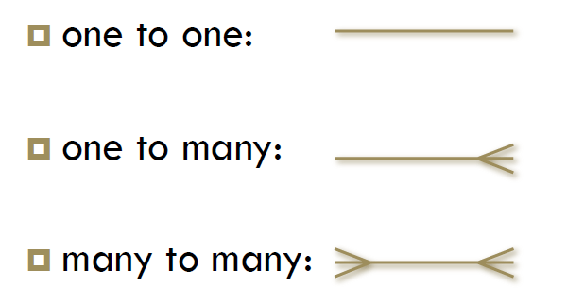
Entity-Relationship Diagrams

Slide 6
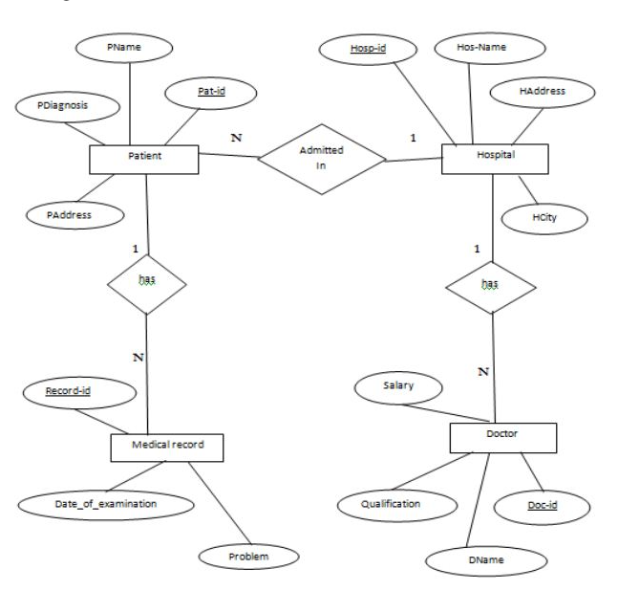
Entity-Relationship Diagrams

Slide 7
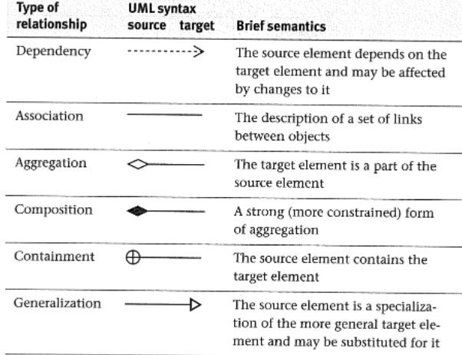
Class Diagram
A Class Diagram represents a system in terms of
objects: akin to entities, organized in classes that have an inheritance hierarchy
attributes: object's variables or characteristics
behaviors: actions on the object's variables

Slide 8
Class Diagram
Class diagram is basically a graphical representation of the static view of the system and represents different aspects of the application. A collection of class diagrams represent the whole system.
The following points should be remembered while drawing a class diagram −
The name of the class diagram should be meaningful to describe the aspect of the system.
Each element and their relationships should be identified in advance.
Responsibility (attributes and methods) of each class should be clearly identified
For each class, minimum number of properties should be specified, as unnecessary properties will make the diagram complicated.

Slide 9
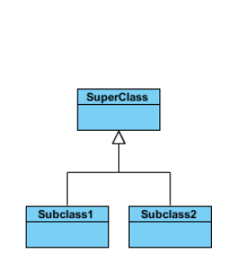
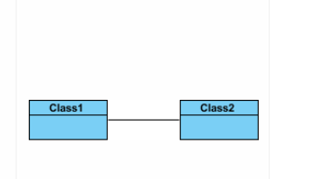
Class Diagram
Class Relationships:
A class may be involved in one or more relationships with other classes.
Inheritance (or Generalization)
Simple Association:

Slide 10
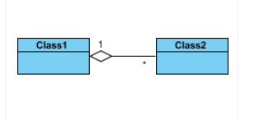
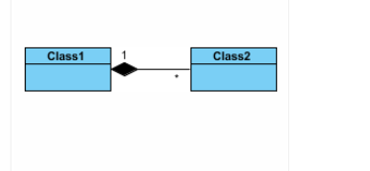
Class Diagram
Aggregation:
A special type of association. It represents a "part of" relationship.
Composition:
A special type of aggregation where parts are destroyed when the whole is destroyed.
Objects of Class2 live and die with Class1.
Class2 cannot stand by itself.

Slide 11
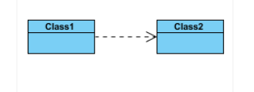
Class Diagram
Dependency
Exists between two classes if the changes to the definition of one may cause changes to the other (but not the other way around).

Slide 12
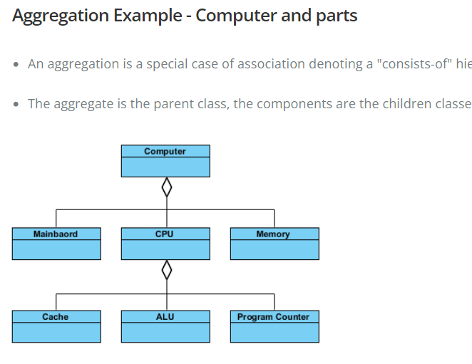
Class Diagram

Slide 13
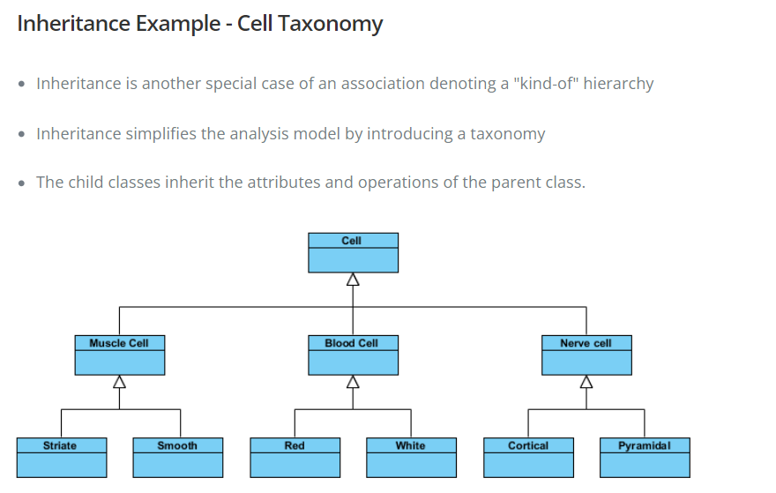
Class Diagram

Slide 14
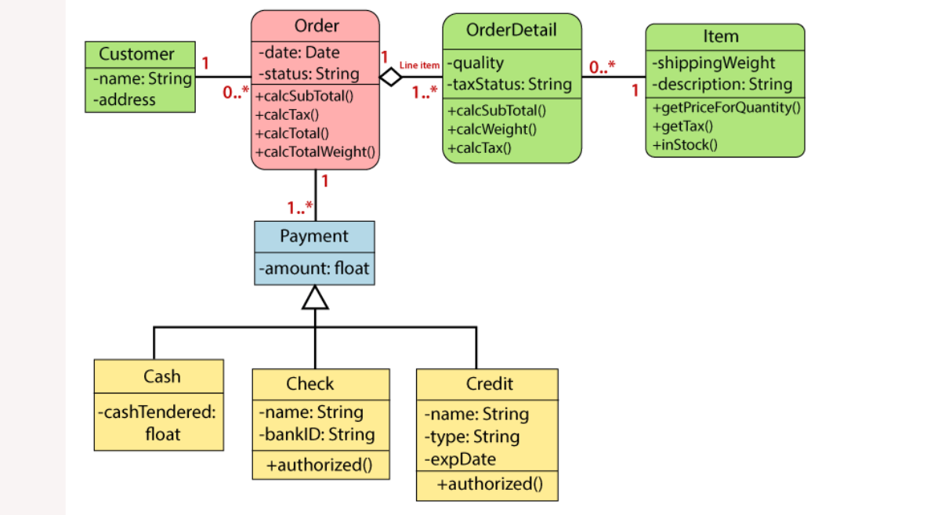
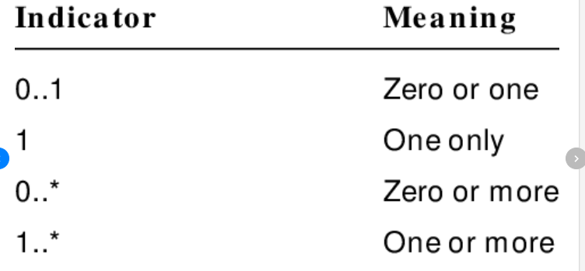
Class Diagram A class diagram describing the sales order system is given below

Slide 15
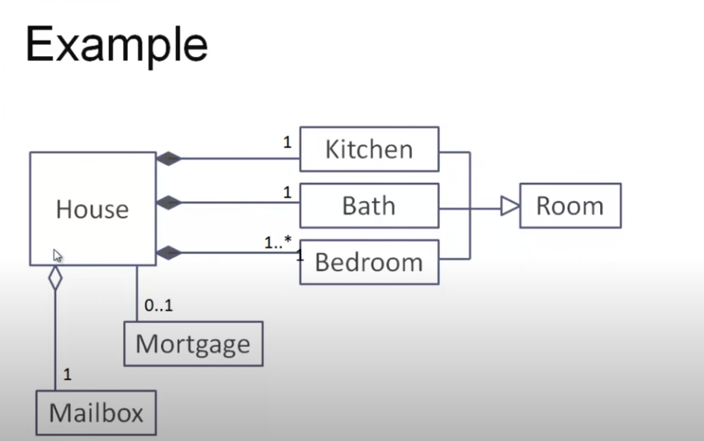
Class Diagram

Slide 16
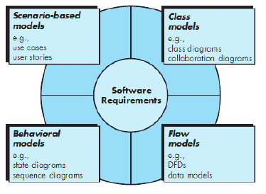
Elements in Analysis Model

Slide 17
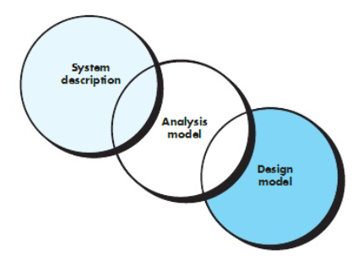
Analysis
Focus on requirements
Each element should improve understanding of requirements
Delay consideration of infrastructure till design
Requirements model provides value to all stakeholders
Keep the models simple

Slide 18
Prioritizing Requirements
Different stakeholders have different set of requirements
potential conflicting ideas
Need to prioritize requirements to resolve conflicts
Prioritization might separate requirements into three categories
essential: absolutely must be met
desirable: highly desirable but not necessary
optional: possible but could be eliminated

Slide 19
References
Pfleeger Book slides from UCF
Acknowledgement!
A few slides have been reused from UCF slides for the SE course

